Slide 1
Object Design
CPSC 2150

Slide 2
Object Design
Much of what we have been talking about falls under the category of Object design
Interfaces
Classes
Class Diagrams
Design By Contract
Inheritance
Object design is focused on identifying the details of our objects
Also the relationships between objects/classes
We use UML class diagrams to show our classes

Slide 3
Relationships between objects
We need to be able to show the relationships between objects and classes
Types of relationships
Associations
Aggregations
Composition
Shared
Inheritance
Delegation

Slide 4
Associations
An association shows a relationship between two or more objects
Identifying associations has advantages
Makes relationships between objects explicit
Enables the developer to discovery boundary cases with associated links
Boundary cases are exceptions that must be clarified within the model
Ex. Emergency reports are written by a field officer.
Can it be multiple officers?
Anonymous reports?

Slide 5
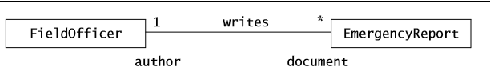
Properties of associations
Name (writes)
Role – identifies the function of each class with respect to the association (author, document)
Multiplicity at each end
* = 0 or more
1 = exactly one
1..* = one or more

Slide 6
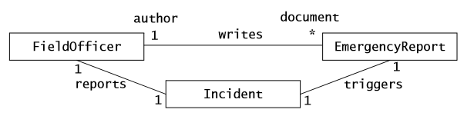
Identifying Associations
Heuristics
Examine verb phrases
Name associations and roles precisely
Eliminate any association that can be derived from other associations
Do not worry about multiplicity until the set of associations is stable
Too many associations make a model unreadable, eliminate redundancies

Slide 7
Practice
How would you draw the Object Association diagram between the following objects
A Course
An Instructor
A section
A student

Slide 8
Aggregations
Aggregations are associations that denote a whole-part relationship
Composition aggregation indicates that the existence of the part depends on the whole
A county is always part of a state
A township is always part of a county
Denoted with a solid diamond
Shared aggregation indicates the whole and the part can exist independently.
Fire engine and fire station
Denoted with a hollow diamond

Slide 9
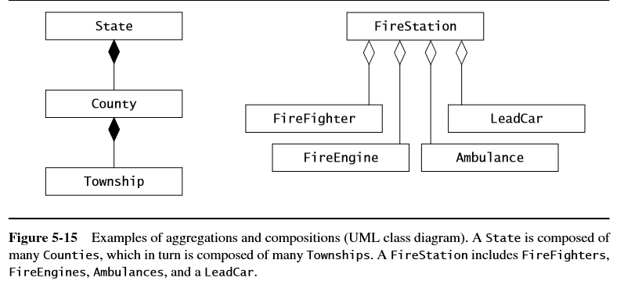
UML Aggregates

Slide 10
Inheritance relationship
Inheritance shows a generalization/specialization relationship
Shows sub-typing
Can generalize by looking at several classes and realize they are all subtypes of the same parent class
Add in the parent class and inherit from it
Can specialize by looking at a class and realizing that we can create more specialized subtypes with shared functionality
Add in the child classes

Slide 11
Delegation
Be wary of implementation inheritance!
Inheritance not because of subtyping, but only to reuse code.
Delegation is a way to avoid implementation inheritance
Delegation
A class implements an operation by sending a message to another class
A class contains an attribute that is typed as another class
Shared aggregation!

Slide 12
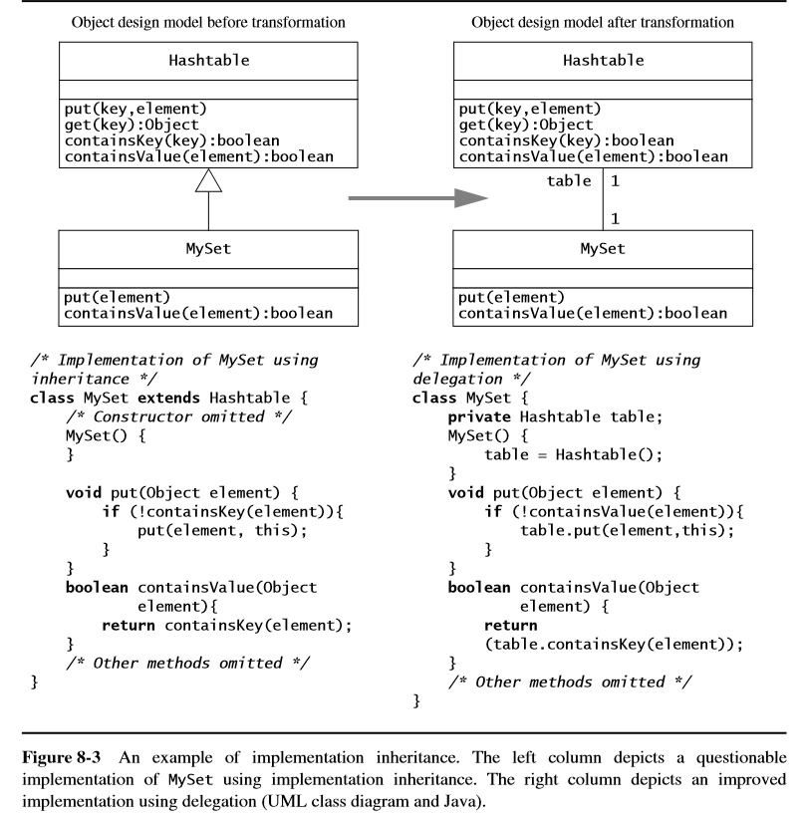

Slide 13
Liskov Substitution Principle
If an object of type S can be substituted in all the places where an object of type T is expected then S is a subtype of T
Meaning
A method written in terms of super class T must be able to use any instance of any subclass S without knowing whether or not it is an instance of a subclass
Consequently, new subclasses can be added to the system without modifying any methods of T or any areas of code that use T.
Previous example: Could not replace any instance of HashTable with MySet, so MySet is not a sub class of HashTable

Slide 14
Class vs Object Diagrams
A class diagram shows the design of the class
An object diagram shows and instance of that object in the system
Includes the specific values of the attributes
Would not include methods

Slide 15
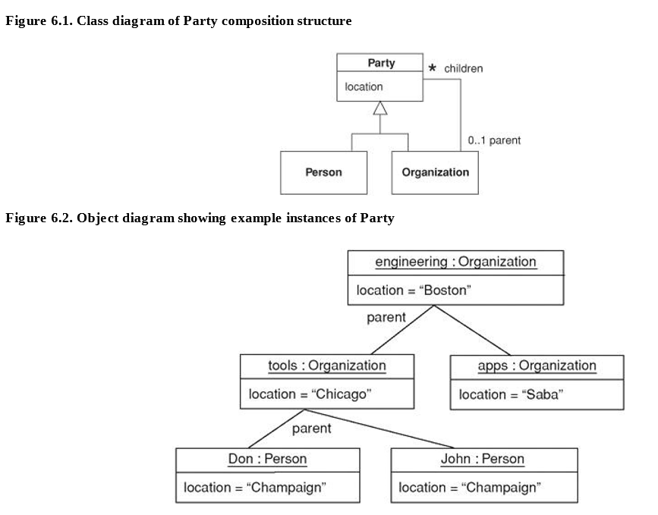

Slide 16
General Notes
Not every UML diagram will include all of this information
Object Association diagrams leave information out
Often times you have a diagram that specifies each class individually
On future diagrams you just include the name of the class
Then reference the individual class diagram for specifics
Often UML is just used for communication between developers, so some information may be left off if it is irrelevant to the current conversation

Slide 17
Transformations
We will discuss 2 types of transformations
Model Transformations
Refactoring

Slide 18
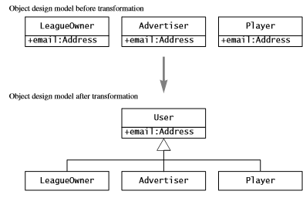
Model Transformations
These are changes to your model
Will affect the code, but not the functionality of the software
Adding a new class to combine attributes
Adding inheritance to link objects together
The development process is a series of model transformations

Slide 19
Refactoring
Transforms the source code
Does not change the functionality
Done to increase
Readability
Modifiability
Implementation of the model transformation

Slide 20
Model Transformations and Refactoring
First you transform the model, then refactor the code
Transforming the model is conceptually difficult but implementation easy
Think of a better design
Change some diagrams
Refactoring is conceptually easy, but difficult to implement
The design decision has been made and the model reflects it
Now you need to go and rewrite code
Can be very time consuming depending on how far along you were and the impact of the change
The more design work you do earlier on, the less time you’ll spend rewriting your own code!

Slide 21
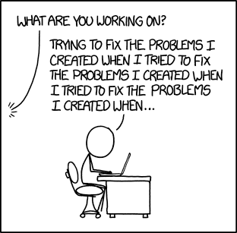
Refactoring
Time spent refactoring is time spent not adding functionality to the system
Have fun explaining to the customer / your boss why you’ve made no “real” progress in a week

Slide 22
Questions to ask during design
Are there any meaningful categories of class types?
Generalization through inheritance
Are there specific specialized types of a class?
Specialization through inheritance
How do these object relate to each other?
Associations
Is one object part of another object
Aggregation
Can they exist independently?
Shared vs Composition

Slide 23
Consider
A burger restaurant that serves a lot of specialty burgers and BYO, as well as sides, salads, and appetizers
Need a system to track order, inventory and customers
Also does delivery and pick up orders.
How would we design these classes and objects?

Slide 24
Implementation
Start in the lower levels of code
Start with entity objects, then control objects, then boundary objects
Testing entity objects on their own is easier, can make simple unit tests
Having stable entity objects makes control objects and boundary objects easier to code
You will need lower level objects in order to code the control and boundary objects anyways
Code the bottom of the stack first

Slide 25
Transferring Class Diagrams
Your class diagrams contain attributes and methods
Attributes are trivial to transfer to code.
Methods to convert multiplicity
Methods are a little more difficult
You need to fill in code to accomplish the operation
You have available:
Name of the method
Parameters
Preconditions
Postconditions

Slide 26
Transferring Methods to Code
Start with simpler getter and setter functions
Start with stub functions for more complicated methods
Just return a hard coded variable
Use sequence diagrams for more info
Sequence diagrams capture how the method is used
Consider who is responsible for contracts
Use Unit tests to verify post conditions

Slide 27
Mapping Associations
Associations are UML Concepts
One-to-One
One-to-Many
Many-to-Many
Unidirectional or Bidirectional
How do these map to our objects?
Collections
Arrays, Lists, etc

Slide 28
Mapping Associations
Unidirectional one-to-one
Object A -> Object B
You don’t ever try to go from B to A
Add an attribute in A that contains B
Bidirectional one-to-one
Object A <-> Object B
Both A and B have to have references to each other in their attributes
Must enforce that those references remain consistent

Slide 29
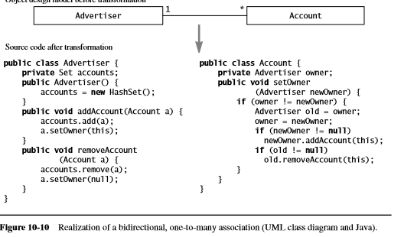
Mapping Associations
One-to-many associations
Unidirectional
Object A has a collection of type Object B
Bidirectional
Object B also has a reference to Object A

Slide 30
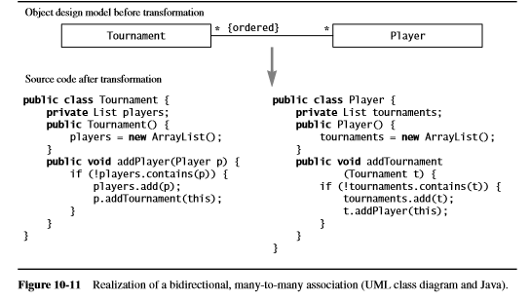
Mapping Associations
Many-to-Many
Both Objects have collections
Must enforce bidirectionality

